Slide 1
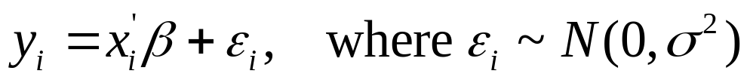
OLS versus ML
To provide some intuition behind the technique of maximum likelihood (ML) estimation;
For illustration, consider the simple linear model:
Draw a random sample {y_{i},x_{i} ; i=1,…,n} from some population;
Imagine one were required to estimate this model by OLS and ML. How do the two methods compare?

Slide 2
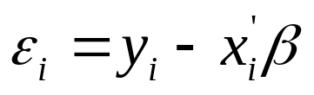
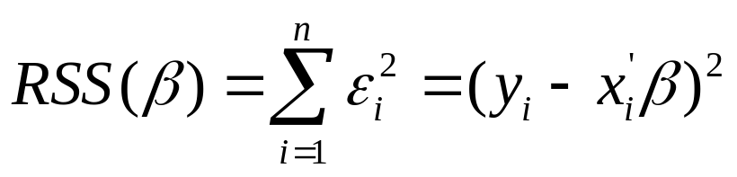

OLS
Draw a random sample {y_{i},x_{i} ; i=1,…,n};
Construct residuals for given parameters β ;
Form residual sum of squares (RSS);
Mimimise this criterion function wrt β
Gives LS estimator

Slide 3
y
E(y|x) = β₁+β₂x
x₁
x₂
x₃
x₄
x₅
……
x_{n}
x

Slide 4
y
E(y|x) = β₁+β₂x ?
x₁
x₂
x₃
x₄
x₅
……
x_{n}
x

Slide 5
y
E(y|x) = β₁+β₂x ?
x₁
x₂
x₃
x₄
x₅
……
x_{n}
x

Slide 6
y
E(y|x) = β₁+β₂x ?
x₁
x₂
x₃
x₄
x₅
……
x_{n}
x

Slide 7
y
E(y|x) = β₁+β₂x ?
x₁
x₂
x₃
x₄
x₅
……
x_{n}
x
ε

Slide 8
y
E(y|x) = β₁+β₂x ?
x₁
x₂
x₃
x₄
x₅
……
x_{n}
x
ε

Slide 9
y
E(y|x) = β₁+β₂x ?
x₁
x₂
x₃
x₄
x₅
……
x_{n}
x
ε

Slide 10
y
E(y|x) = β₁+β₂x ?
x₁
x₂
x₃
x₄
x₅
……
x_{n}
x
ε

Slide 11
y
E(y|x) = β₁+β₂x ?
x₁
x₂
x₃
x₄
x₅
……
x_{n}
x
ε

Slide 12
y
E(y|x) = β₁+β₂x ?
x₁
x₂
x₃
x₄
x₅
……
x_{n}
x
ε

Slide 13
ε

Slide 14
ε²

Slide 15
ε²

Slide 16
ε²

Slide 17
ε²

Slide 18
ε²

Slide 19
y
E(y|x) = β₁+β₂x ?
x₁
x₂
x₃
x₄
x₅
……
x_{n}
x

Slide 20
y
E(y|x) = β₁+β₂x ?
x₁
x₂
x₃
x₄
x₅
……
x_{n}
x

Slide 21
y
E(y|x) = β₁+β₂x ?
x₁
x₂
x₃
x₄
x₅
……
x_{n}
x

Slide 22
ε
ε
y
ε
E(y|x) = β₁+β₂x ?
ε
ε
x₁
x₂
x₃
x₄
x₅
……
x_{n}
x

Slide 23
y
E(y|x) = β₁+β₂x ?
x₁
x₂
x₃
x₄
x₅
……
x_{n}
x
ε

Slide 24
y
E(y|x) = β₁+β₂x ?
x₁
x₂
x₃
x₄
x₅
……
x_{n}
x
ε

Slide 25
ε

Slide 26
ε²

Slide 27
OLS
Draw a random sample {y_{i},x_{i} ; i=1,…,n};
Construct residuals for given parameters β ;
Form residual sum of squares (RSS);
Mimimise this criterion function wrt β
Gives LS estimator

Slide 28
OLS
Draw a random sample {y_{i},x_{i} ; i=1,…,n};
Construct residuals for given parameters β ;
Form residual sum of squares (RSS);
Mimimise this criterion function wrt β
Gives LS estimator
ML
Draw a random sample {y_{i},x_{i} ; i=1,…,n};
Construct residuals for given parameters β ;

Slide 29
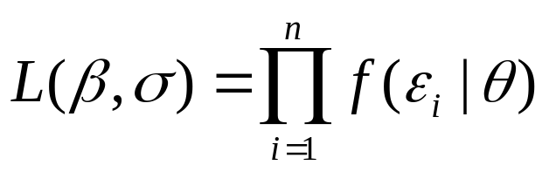
OLS
Draw a random sample {y_{i},x_{i} ; i=1,…,n};
Construct residuals for given parameters β ;
Form residual sum of squares (RSS);
Mimimise this criterion function wrt β
Gives LS estimator
ML
Draw a random sample {y_{i},x_{i} ; i=1,…,n};
Construct residuals for given parameters β ;
Form likelihood function L(β);

Slide 30
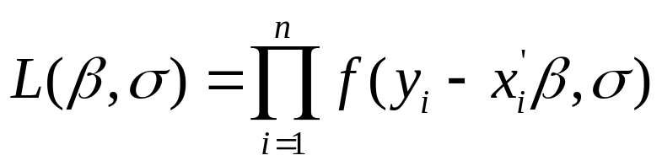
OLS
Draw a random sample {y_{i},x_{i} ; i=1,…,n};
Construct residuals for given parameters β ;
Form residual sum of squares (RSS);
Mimimise this criterion function wrt β
Gives LS estimator
ML
Draw a random sample {y_{i},x_{i} ; i=1,…,n};
Construct residuals for given parameters β ;
Form likelihood function L(β);

Slide 31
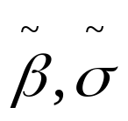
OLS
Draw a random sample {y_{i},x_{i} ; i=1,…,n};
Construct residuals for given parameters β ;
Form residual sum of squares (RSS);
Mimimise this criterion function wrt β
Gives LS estimator
ML
Draw a random sample {y_{i},x_{i} ; i=1,…,n};
Construct residuals for given parameters β ;
Form likelihood function L(β);
Maximise this criterion function wrt β and σ
Gives ML estimator

Slide 32
y
E(y|x) = β₁+β₂x
x₁
x₂
x₃
x₄
x₅
……
x_{n}
x

Slide 33
y
E(y|x) = β₁+β₂x ?
x₁
x₂
x₃
x₄
x₅
……
x_{n}
x

Slide 34
y
E(y|x) = β₁+β₂x ?
x₁
x₂
x₃
x₄
x₅
……
x_{n}
x

Slide 35
y
E(y|x) = β₁+β₂x ?
x₁
x₂
x₃
x₄
x₅
……
x_{n}
x

Slide 36
y
E(y|x) = β₁+β₂x ?
x₁
x₂
x₃
x₄
x₅
……
x_{n}
x
f(ε)

Slide 37
y
E(y|x) = β₁+β₂x ?
x₁
x₂
x₃
x₄
x₅
……
x_{n}
x
f(ε)

Slide 38
y
E(y|x) = β₁+β₂x ?
x₁
x₂
x₃
x₄
x₅
……
x_{n}
x

Slide 39
y
E(y|x) = β₁+β₂x ?
x₁
x₂
x₃
x₄
x₅
……
x_{n}
x

Slide 40
y
E(y|x) = β₁+β₂x ?
x₁
x₂
x₃
x₄
x₅
……
x_{n}
x

Slide 41
y
E(y|x) = β₁+β₂x ?
x₁
x₂
x₃
x₄
x₅
……
x_{n}
x
f(ε)

Slide 42
y
E(y|x) = β₁+β₂x ?
x₁
x₂
x₃
x₄
x₅
……
x_{n}
x
f(ε)

